Slide 1
Zero Downtime Proof Of Concept
Architecture and Principles

Slide 2
Goal
Proof for an Azure PaaS Deployment Architecture
Provide a foundational Architecture to form the basis of new greenfield deployment patterns for NBME’s Azure adoption
Primary Stakeholders:
Application Development team
& IT Operations

Slide 3
Principles
Showcase ease of Operations

Slide 4
Design
Scenario: Assuming a three tier application, changes to any of the tier should not cause downtime
Part - 1 | Deploy a multi-tier architecture in 1-region (East US).
Foundational | 1 | App Gateway and/or Traffic Manager
 | 2 | Front-end App Service
 | 3 | Middle-tier Azure Function (as a proxy to business logic)
 | 4 | Cosmos DB
Part-2 | 1 | Introduce a version change to Middle-tier and CosmosDB
 | 2 | Deploy & Monitor Zero downtime
Part-3 | 1 | Introduce a version change to Front-end
 | 2 | Deploy & Monitor Zero downtime

Slide 5
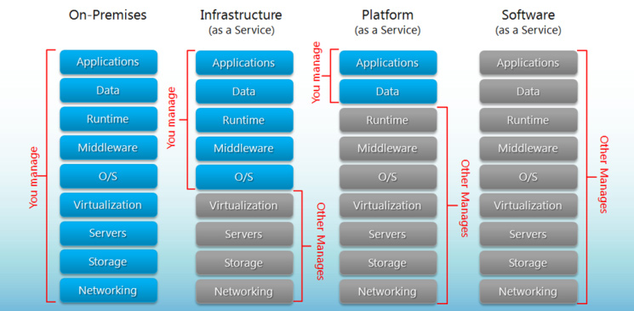
R & R

Slide 6











DEMO
SEQUENCE
Proposed
RG-NETWORKING
RG-OPERATIONS
A controller like
Traffic Manager / Application Gateway
STEP | EVENT
0 | Blank Azure Subscription
1 | Site admin DEPLOYS entire stack containing V1 Monitors traffic
OMS / Log Search
RG-V2
RG-V1
2 | Site Admin DEPLOYS v2 stack. No production traffic to v2 Monitors traffic.
verifies
FE
FE
3 | DevOps team VERIFIES V2 is working fine Monitors traffic
DevOps
App Insights
MID
TIER
MID
TIER
4 | Site admin and DevOps Puts v2 in rotation. Some live traffic to v2 Monitors traffic
5 | Site admin and DevOps Deprecates v1
RG-BACKEND
Azure Monitor
Notes:
At any time, only one of the environments is live, with the live environment serving all production traffic. For this example, Blue is currently live and Green is idle.

Slide 7

Single Region Zero Downtime
DEMO
SEQUENCE
Proposed
Traffic Manager
RG-NETWORKING
RG-OPERATIONS
Application Gateway
(use as a regional controller)
STEP | EVENT
0 | Blank Azure Subscription
1 | Site admin DEPLOYS entire stack containing V1 Monitors traffic
OMS / Log Search
RG-V2
RG-V1
2 | Site Admin DEPLOYS v2 stack. No production traffic to v2 Monitors traffic.
verifies
FE
FE
3 | DevOps team VERIFIES V2 is working fine Monitors traffic
DevOps
App Insights
MID
TIER
MID
TIER
4 | Site admin and DevOps Puts v2 in rotation. Some live traffic to v2 Monitors traffic
5 | Site admin and DevOps Deprecates v1
RG-BACKEND
Azure Monitor
Notes:
At any time, only one of the environments is live, with the live environment serving all production traffic. For this example, Blue is currently live and Green is idle.

Slide 8
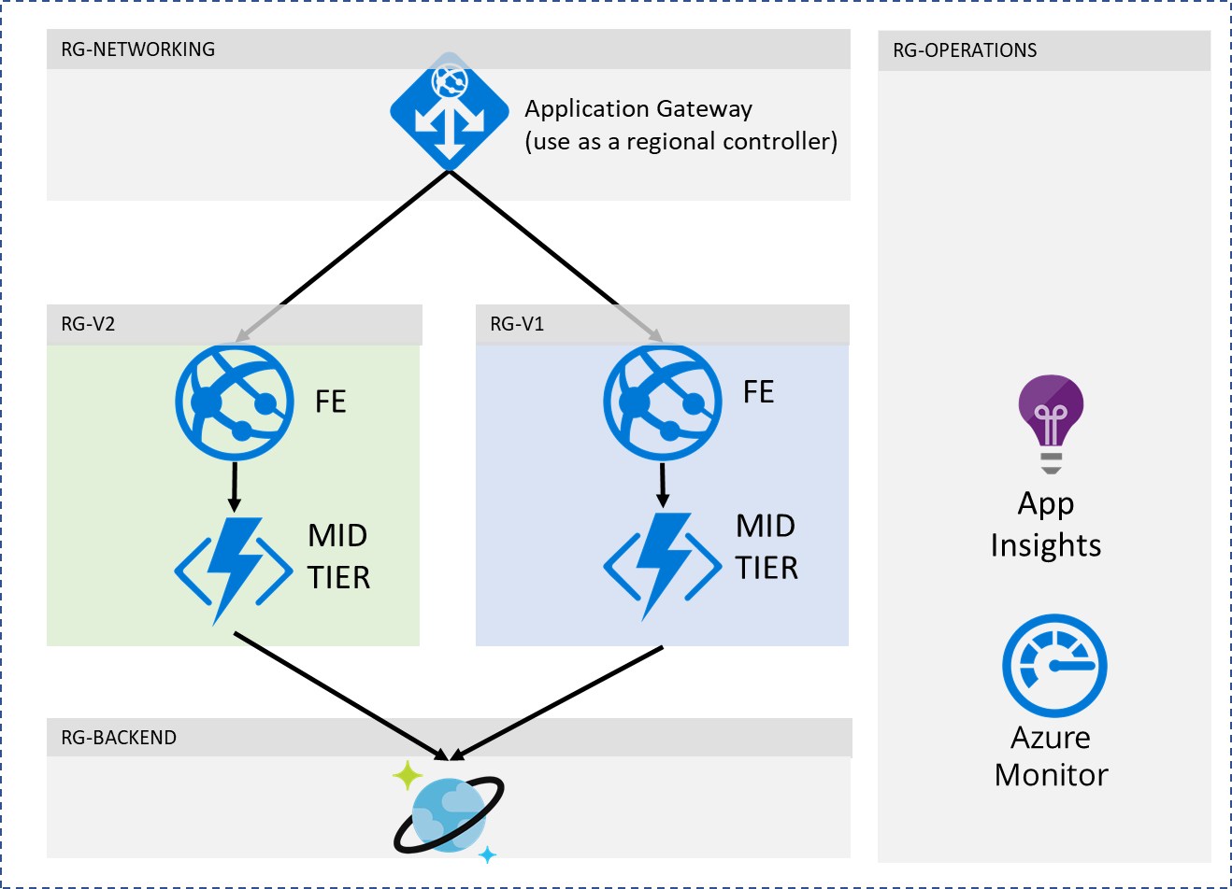
Multi Region Deployment
Traffic Manager
Region 1
Region 2

